Slide 1

Unit 6 - Lesson 3
Unreasonable Time

Slide 2


Slide 3

Unit 6 Lesson 3 - Warm Up
Prompt:
What does it mean to say one algorithm is “more efficient” than another?

Slide 4


Slide 5

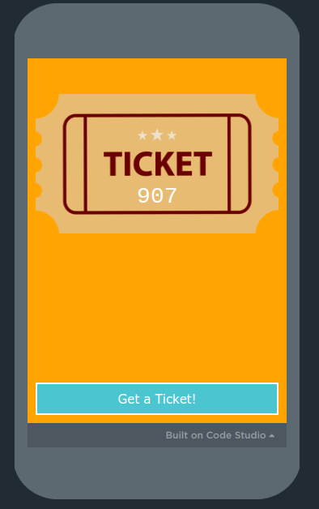
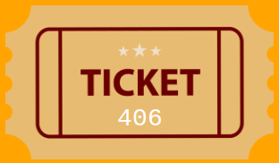
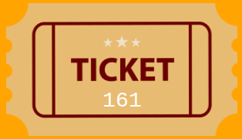

Unit 6 Lesson 3 - Activity
The Pair Raffle
The winners are any two tickets that adds to the winning number.
The winning number is 1000.
Do This
Generate a ticket
Silently move around the room.
See if you’re a part of a winning pair!

Slide 6
Unit 6 Lesson 3 - Activity
The Group Raffle
The winners are any group of (from one ticket up to all of them) that adds to the winning number.
The winning number is 2500.
Do This
Generate a ticket
Move around the room (you can talk this time
See if you’re part of a winning group!

Slide 7
Unit 6 Lesson 3 - Activity
Prompt
Which raffle felt like it was more difficult to check? Why?

Slide 8
Unit 6 Lesson 3 - Activity
We could write an algorithm that goes through every possible “check” for the pair raffle or the group raffle.
Let’s see how many checks there are!
With your partner fill in the two tables on the activity guide.

Slide 9
Unit 6 Lesson 3 - Activity
Share your responses with another group!

Slide 10
Unit 6 Lesson 3 - Activity
tickets | checks
2
3
4
5
8
Pair raffle
10 9 8 7 6 5 4 3 2 1
checks
1 2 3 4 5 6 7 8 9 10
tickets

Slide 11
Unit 6 Lesson 3 - Activity
tickets | checks
2 | 1
3 | 3
4 | 6
5 | 10
8 | 28
Pair raffle
The exact formula for this relationship is
(n² - n)/2
You don’t need to know that formula, but you should know that because of the “n-squared” term the graph curves up.
Any algorithm whose efficiency includes an n², n³, n⁴ … is called polynomial.
10 9 8 7 6 5 4 3 2 1
checks
1 2 3 4 5 6 7 8 9 10
tickets

Slide 12
Unit 6 Lesson 3 - Activity
tickets | checks
2
3
4
5
8
Group raffle
10 9 8 7 6 5 4 3 2 1
checks
1 2 3 4 5 6 7 8 9 10
tickets

Slide 13
Unit 6 Lesson 3 - Activity
tickets | checks
2 | 3
3 | 7
4 | 15
5 | 31
8 | 255
Group raffle
The exact formula for this relationship is
(2^{n}) - 1
You don’t need to know that formula, but you should know that because of the “2 to the n” term the graph curves up very quickly.
Any algorithm whose efficiency includes an 2^{n}, 3^{n}, 4^{n} … is called exponential.
10 9 8 7 6 5 4 3 2 1
checks
1 2 3 4 5 6 7 8 9 10
tickets

Slide 14
Unit 6 Lesson 2 - Activity
There's another way of thinking about this.
The number of checks is the largest number you can make with that many bits.
tickets | checks
1 | 1
2 | 3
3 | 7
4 | 15
5 | 31
8 | 255
1
1
1
1
1
1
1
1
1
1

Slide 15
Unit 6 Lesson 3 - Activity
Which graphs are unreasonable?
Exponential / Group Raffle
Polynomial / Pair Raffle
Linear / Normal Raffle
checks
Log / Sorted Raffle
tickets

Slide 16
Unit 6 Lesson 3 - Activity
Polynomial and Exponential both curve up.
Why do you think only exponential is considered “unreasonable”?
Exponential / Group Raffle
Unreasonable
Polynomial / Pair Raffle
Reasonable
Linear / Normal Raffle
Reasonable
checks
Log / Sorted Raffle
Reasonable
tickets

Slide 17
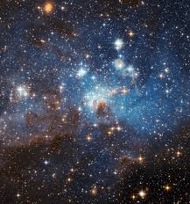
Unit 6 Lesson 3 - Activity
Tickets | Sorted Raffle log | Normal Raffle linear | Pair Raffle polynomial | Group Raffle exponential
10 | 4 Checks | 10 checks | 100 checks | 1,024 checks
20 | 5 checks | 20 checks | 400 checks | 1,048,576 checks
100 | 7 checks | 100 checks | 10,000 checks | 1.26 * 10³⁰ checks
1000 | 10 checks | 1,000 checks | 1,000,000 checks | 1.07 * 10³⁰¹ checks
10,000 | 14 checks | 10,000 checks | 100,000,000 checks | 2.00 * 10³⁰¹⁰ checks
100,000 | 17 checks | 100,000 checks | 10,000,000,000 checks | 9.99 * 10³⁰¹⁰² checks
At this point there are more checks than atoms in the universe
Polynomial is bad but exponential gets unreasonably large extremely quickly.

Slide 18


Slide 19

Unit 6 Lesson 3 - Wrap Up
Reasonable Time: Algorithms with a polynomial efficiency or lower (constant, linear, square, cube, etc.) are said to run in a reasonable amount of time.
Unreasonable Time: Algorithms with exponential or factorial efficiencies are examples of algorithms that run in an unreasonable amount of time.

Slide 20
Unit 6 Lesson 3 - Wrap Up
Prompt:
Your school is considering running the group raffle at an upcoming assembly to give away a prize.
Write a brief explanation of what advice you would give them.

Slide 21

Unit 3 Lesson 10 - Activity
Unit Assessment

